Slide 1

Códex Inteligente Empowering individuals with visual disabilities through innovative technology, fostering independence and enhanced perception of their surroundings.
SAFE STEP

Slide 2
The Challenge: Navigating a Complex World
Hidden hazards in public & private spaces
Navigation difficulties limit freedom & activities
Risk of falls and collisions
Reduced confidence & mobility

Slide 3
Our Solution:
Real-time obstacle detection – The system quickly spots obstacles as the user moves.
Distance measurement to objects – It tells how close or far an obstacle is.
Intuitive feedback (audio & vibration) – Simple sounds and gentle vibrations guide the user.
Safer, more independent navigation – Helps users move confidently without relying on others.

Slide 4
How It Works
Real-time Data Collection – Sensors pick up what’s happening around the user
AI Models – The system understands and labels nearby obstacles
Distance Measurement – Tells how far away the obstacle is
User Feedback – Guides the user with simple sounds or gentle vibrations

Slide 5
Backend & Simulation Support
Flask Backend – Manages sensor data flow and system communication for quick response
Blender – Handles heavy 3D computations for accurate rendering in real time
VR Simulation (A-Frame) – Creates 3D virtual environments to test and train obstacle detection safely

Slide 6
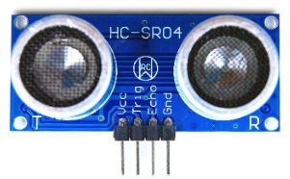
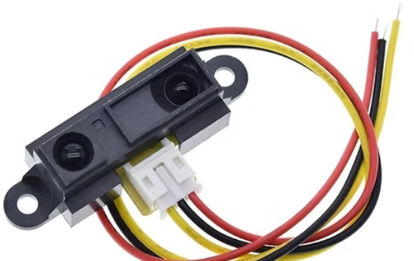
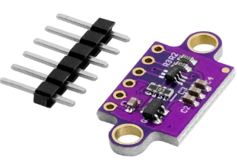
Sensors – The Eyes of the System
HC-SR04 (Ultrasonic) – Uses sound waves to find obstacles and measure distance
VL53L0X (Laser ToF) – Uses a laser to measure short distances accurately
Sharp GP2Y0A21 (IR) – Uses infrared light to detect nearby objects
MPU6050 (Motion Sensor) – Tracks movement, direction, and falls
Vibration Motor / Buzzer – Alerts the user with vibration or sound

Slide 7
User Experience & Accessibility
Audio cues – Different tones & frequencies indicate obstacle distance and direction
Minimal interaction – User can focus on navigation without complex controls
Vibration alerts – Subtle, non-intrusive vibrations provide extra guidance
Ease of use – Simple, intuitive design reduces effort for the user

Slide 8
Impact
Increased confidence in navigation
Reduced risk of accidents
Greater mobility & independence
Social participation improvement
Enhanced quality of life

Slide 9
Future Roadmap
Real-time dynamic maps – Live mapping of surroundings
Smart urban integration – Connects with city systems for safer navigation
Customizable profiles – Personalized alerts and user settings

